Slide 1
Nervous Systems

Slide 2
Nervous System: The Central Nervous System
Consists of the brain and the spinal cord
I. Brain:
mass of nerve tissues
  located in the cranial cavity (head).
receives information from the spinal cord as well as from nerves in the cranial cavity (head) such as smell, taste (olfactory nerves) and sight (optic nerves).
interprets the received information.
acts upon the received information by controlling the muscles and glands of the body.

Slide 3
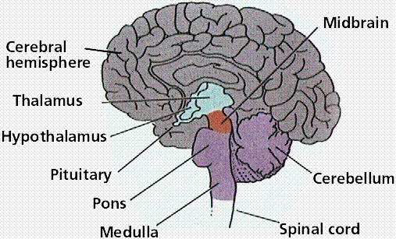
a) The Human Brain
The brain of all vertebrates consist of a cerebrum, cerebellum, and a medulla oblongata.
The brain receives nerve impulses (information) from the spinal cord and 12 pairs of cranial nerves (nerves that exist within the head).
  EX: The optic and olfactory nerves

Slide 4
1. The Medulla Oblongata
Medulla oblongata (the brain stem)connects to the spinal cord and regulates most involuntary actions of the body including:
Breathing by regulating the intercostal muscles and diaphragm
Heartbeat
Diameter of blood vessels
Reflexes for vomiting, coughing, sneezing, swallowing, and hiccuping.
2. The Cerebellum
The cerebellum function is to coordinate body movements.
The cerebellum appears to be a center for learning motor skills.
3. The Cerebrum
The largest section of the brain that is responsible for thinking, emotion, judgement, memory, sensation.

Slide 5
II. Spinal cord is mass of nerve tissue in the vertebral cavity (backbone) that is connected to a large network of nerves (peripheral nervous system) .
The Spinal cord runs along the dorsal side of the body (backside) and links the brain to the rest of the body
The spinal cord contains nerve cells called interneurons.
a) Function:
1. To send information from the peripheral nervous system (nerves of the body) to the brain.
2. To send information from the brain to our various effectors such as muscles and glands.
3. To serve as a reflex center.

Slide 6
III. Peripheral Nervous System: PNS
Nervous system outside of the brain and the spinal cord.
Types of Nerves in the PNS
1. Cranial nerves (nerves from the brain)
2. Spinal nerves (communication between the body and the CNS).
b) The Sensory division of the PNS is made up of Sensory Neurons which relays information from the body to the brain.
c) The Motor division of the PNS is made up of Motor Neurons which relays information from the brain to the body.

Slide 7
  d) Two components of the motor division of the PNS
    1. somatic nervous system:
      voluntary skeletal muscles (soma=body)
    2. autonomic nervous system
      involuntary
      sympathetic (excitatory) and parasympathetic (inhibitory) division of the ANS which cause antagonistic effects in the human body.

Slide 8
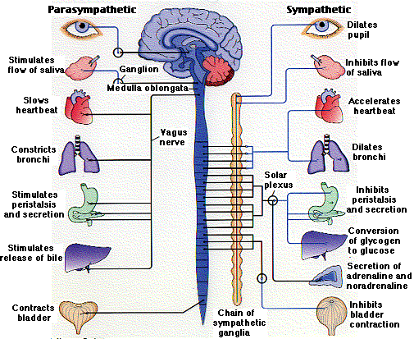
From: http://users.rcn.com/jkimball.ma.ultranet/BiologyPages/P/PNS.html

Slide 9
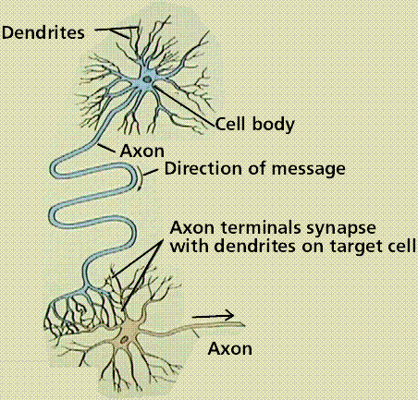
  IV. Neurons
    a) Neuron Structure
    Cell bodies (Cytons) contain the nucleus of the cell.
    2. Dendrites: branching structures that receives information from other neurons and carries it toward the cell body.
    3. Axon long projections from the cell body that carries nerve impulse (information) away from the cell body.
      4. Terminal branches contain neurotransmitters that are released in to the synapse to allow for nerve impulse transmission.
Structure of a neuron and the direction of nerve message transmission. Image from Purves et al., Life: The Science of Biology, 4th Edition, by Sinauer Associates (www.sinauer.com) and WH Freeman (www.whfreeman.com), used with permission.

Slide 10
V. Steps in an Action Potential
a) The Nerve Impulse
1. Neurons have an unequal distribution of ions and electrical charges between the two sides of the cell membrane.
Outside of the membrane has a positive charge due to a high concentration of sodium ions.
Inside has a negative charge due to a high concentration of potassium ions. This charge difference is a resting potential and is measured in millivolts.
2. Passage of ions across the cell membrane passes the electrical charge along the cell. The voltage potential is -65mV (millivolts) of a cell at rest (resting potential). Resting potential results from differences between sodium and potassium positively charged ions and negatively charged ions in the cytoplasm.
3. This imbalance is maintained by the active transport of ions to reset the membrane known as the sodium potassium pump. The sodium-potassium pump maintains this unequal concentration by actively transporting ions against their concentration gradients.

Slide 11
b) Nerve Impulse Propagation:
1. Changed polarity of the membrane, the action potential, results in propagation of the nerve impulse along the membrane.
An action potential is a temporary reversal of the electrical potential along the membrane for a few milliseconds.
2. Sodium gates and potassium gates open in the membrane to allow their respective ions to cross.
Sodium and potassium ions reverse positions by passing through membrane protein channel gates that can be opened or closed to control ion passage.
3. The action potential begins at one spot on the membrane, but spreads to adjacent areas of the membrane, propagating the message along the length of the cell membrane.
After passage of the action potential, there is a brief period, the refractory period, during which the membrane cannot be stimulated. This prevents the message from being transmitted backward along the membrane.

Slide 12
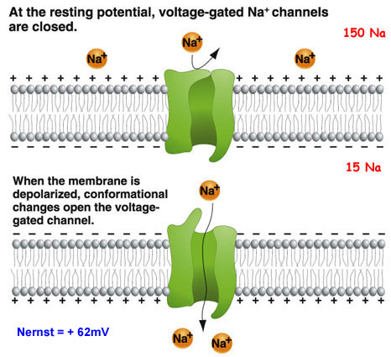

Slide 13
c) Steps in Nerve Impulse Transmission and Propagation
1. At rest the outside of the membrane is more positive than the inside.
2. Sodium moves inside the cell causing an action potential, the influx of positive sodium ions makes the inside of the membrane more positive than the outside.
3. Potassium ions flow out of the cell, restoring the resting potential net charges.
4. Sodium ions are pumped out of the cell and potassium ions are pumped into the cell, restoring the original distribution of ions.

Slide 14
VI. Nerve Impulse Transmission and Neuron Structure
a) Axons are wrapped in a myelin sheath formed from the plasma membranes of specialized glial cells (supporting cells) known as Schwann cells.
b) Schwann cells serve as supportive, nutritive, and service facilities for neurons.
c) The gap between Schwann cells is known as the node of Ranvier, and serves as points along the neuron for generating a signal.
Signals jumping from node to node travel hundreds of times faster than signals traveling along the surface of the axon. This allows your brain to communicate with your toes in a few thousandths of a second.

Slide 15
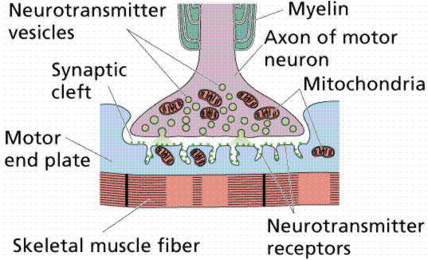
VII. Synapses: The connection between a nerve cell and another cell is called a synapse.
a) The information that is carried throughout our nervous system is an electrochemical message known as a nerve impulse. The space between two cells is known as the synapse.
b) To cross the synapse requires the actions of neurotransmitters are needed. Neurotransmitters are stored in the terminal branches of the axon. .
A synapse. Image from Purves et al., Life: The Science of Biology, 4th Edition, by Sinauer Associates (www.sinauer.com) and WH Freeman (www.whfreeman.com), used with permission.

Slide 16
c) Arrival of the nerve impulse causes the neurotransmitters to be released into the synapse.
d) Released neurotransmitters bind to receptors on the other cell's membrane allowing the nerve impulse to travel into the adjacent neuron.
e) Neurotransmitters tend to be small molecules, some are even hormones.
The time for neurotransmitter action is between 0.5 and 1 millisecond.
Acetylcholine is an example of a neurotransmitter that acts in neuromuscular junctions. It aids in the control of muscle contraction by allowing nerve impulses to be transmitted to muscles (effectors) from motor neurons.
Norepinephrine or noradrenaline: Along with epinephrine, this compound effects the fight-or-flight response, activating the sympathetic nervous system to directly increase heart rate, release energy from glycogen, and increase muscle readiness.

Slide 17
i) Diseases that affect the function of the nerve impulse can have serious consequences.
1. Parkinson's disease has a deficiency of the neurotransmitter dopamine.
Symptoms include tremors, rigidity and unstable posture.
Treatment: L-dopa is a chemical related to dopamine that eases some of the inevitably irreversible symptoms.
2. Tetanus: The bacterium Clostridium tetani produces a toxin that prevents the release of neurotransmitters.
Without the neurotransmitters regulation of muscles is lost; it can be fatal when it effects the muscles used in breathing.
3. Botulism: The bacterium Clostridium botulinum produces a toxin found in improperly canned foods. This toxin causes the progressive relaxation of muscles, and can be fatal.
A wide range of drugs also operate in the synapses: cocaine, LSD, caffeine, and insecticides.

Slide 18
4. Multiple Sclerosis: a chronic progressive nervous disorder involving loss of myelin sheath around certain nerve fibers of the brain or spinal cord (or both), interfering with the nerve pathways and causing muscular weakness, loss of coordination and speech and visual disturbances. It occurs chiefly in young adults and is thought to be a defect in the immune system that may be of genetic or viral origin.
5. Meningitis: inflammation of the membranes (meninges) covering the brain and the spinal cord. Although the most common causes are infection (either bacterial or viral), chemical agents and even tumor cells may cause meningitis. Encephalitis and brain abscess can complicate infective meningitis.

